Slide 1

The History of Artificial Intelligence
From Early Dreams to Agentic AI
Prepared by: Munazha Irfan

Slide 2
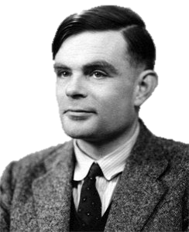
Early Foundations (1940s–1950s)
In the 1940s, Alan Turing imagined machines that could think like humans. In 1950, he proposed the Turing Test as a way to check if a machine could convincingly imitate human conversation.
The 1956 Dartmouth Conference officially marked the birth of Artificial Intelligence as a research field.

Slide 3
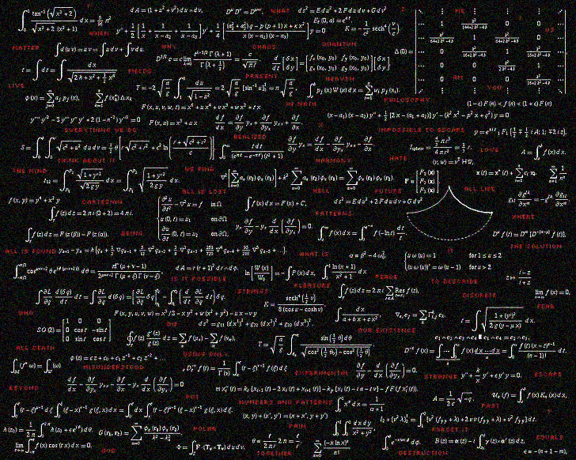
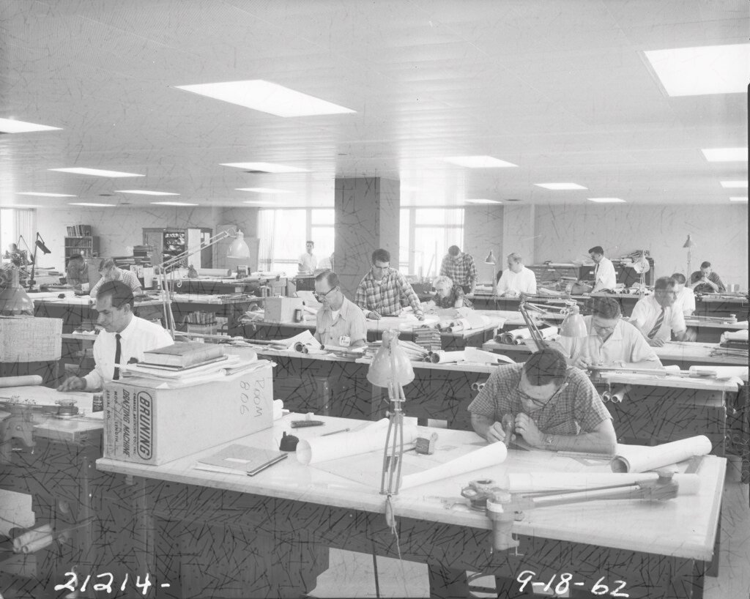
Symbolic AI & Expert Systems (1960s–1970s)
Researchers focused on symbolic reasoning, believing intelligence could be captured with rules and logic.
Expert systems emerged, helping in medicine, engineering, and business. They were powerful but limited, struggling with flexibility and real-world uncertainty.

Slide 4

The AI Winters (1970s–1990s)
Overpromises and high expectations led to disappointment and funding cuts, known as the 'AI Winters'.
Many believed AI was a failed dream, but dedicated researchers continued working in the background, laying foundations for future progress.

Slide 5
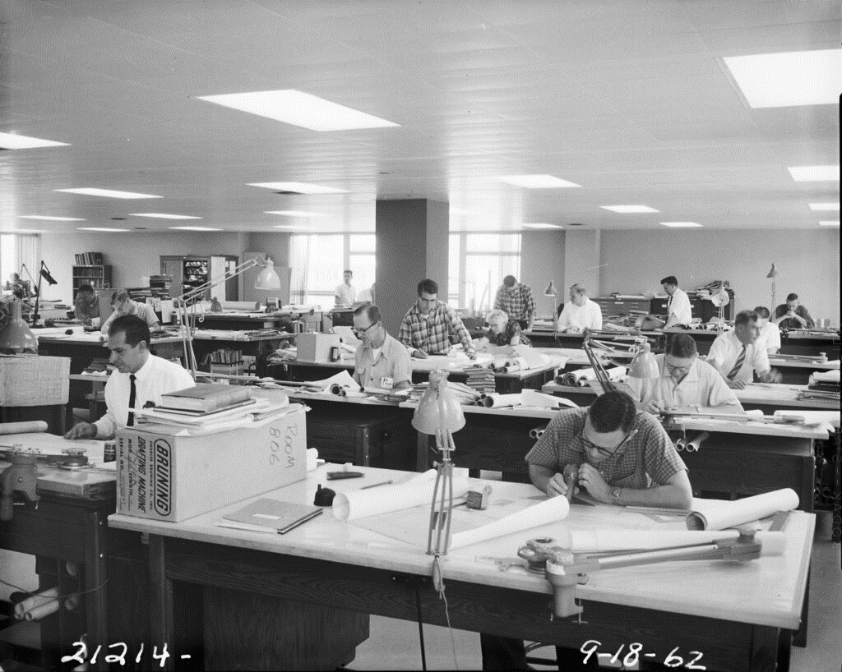
Machine Learning Revolution (1990s–2010s)
AI shifted from rule-based systems to data-driven approaches.
Algorithms like Decision Trees, Support Vector Machines, and Neural Networks powered applications such as speech recognition, spam filters, and recommendation systems.

Slide 6
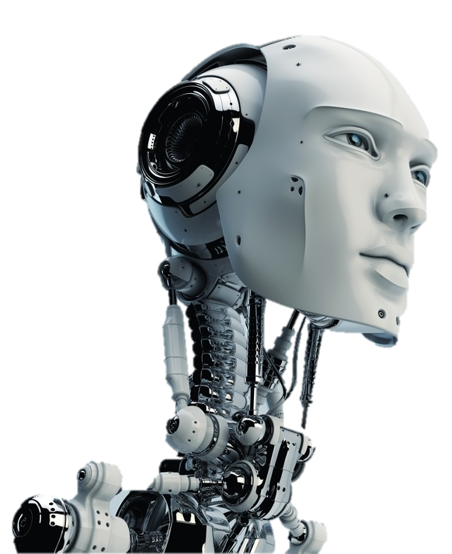
Deep Learning Boom (2010s)
With the rise of big data and GPU computing, AI experienced a breakthrough.
In 2012, AlexNet’s victory in the ImageNet competition transformed computer vision and sparked the deep learning era.
AI soon surpassed humans in tasks like image recognition and translation.

Slide 7


Generative AI (2020s)
Transformers like GPT and BERT allowed AI to generate human-like text, images, audio, and video.
Tools such as ChatGPT, Stable Diffusion, and MidJourney brought AI into the mainstream, reshaping creativity, communication, and work.

Slide 8
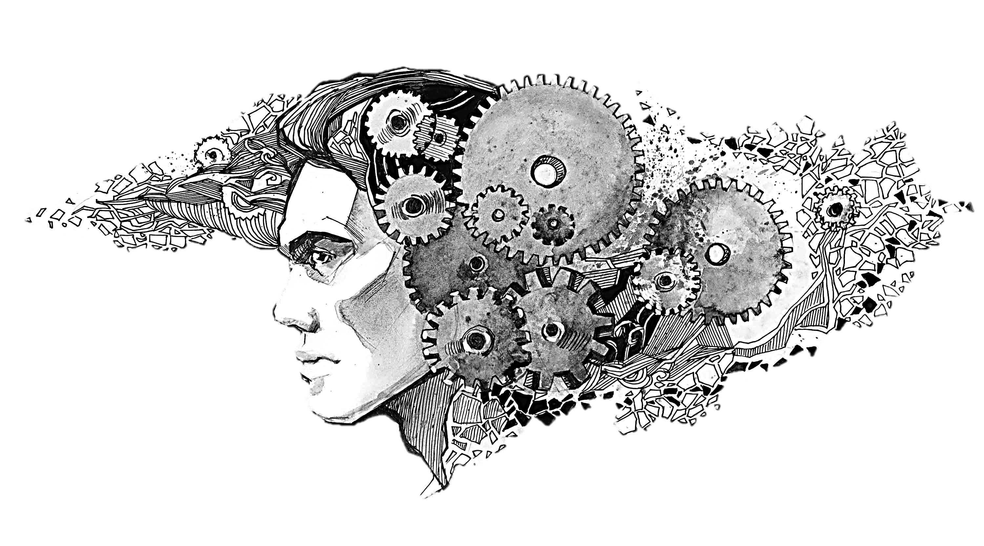
Agentic AI (Now & Future)
AI is evolving from being just a tool to becoming an autonomous agent.
It can plan, reason, and execute multi-step tasks while integrating with external tools.
Agentic AI brings exciting opportunities but also raises ethical and societal concerns.

Slide 9
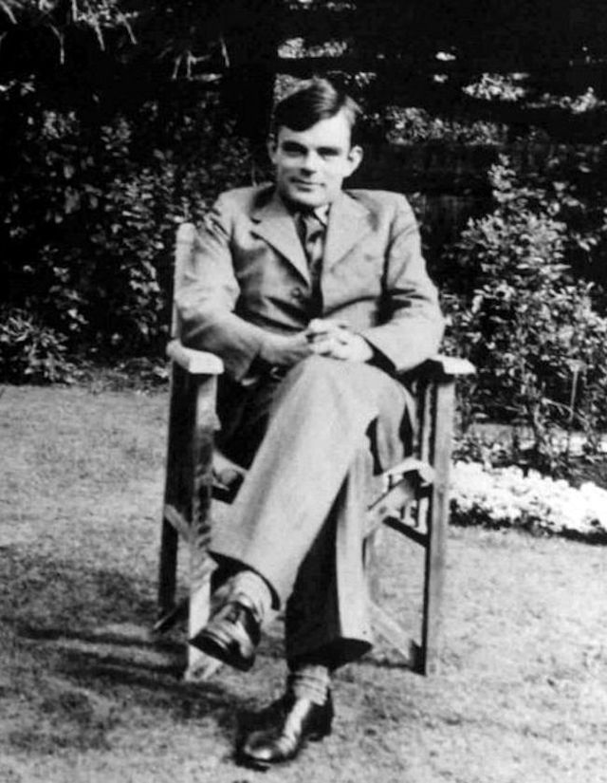
Conclusion
The history of AI shows cycles of ambition, doubt, and breakthrough.
From symbolic reasoning to agentic systems, every stage built on the previous one.
The future of AI depends on how humanity chooses to shape and guide its development.

